Slide 1

Major Project on
A.I. Driven System for Traffic Violation and Detection
Under the guidance of :
Dr. Chandradeep Bhatt
(Dept. of Computer Science and Engineering)
Submitted By :
Shristi Gusain (Univ Roll No : 2218050)
Nidhi Kaintura (Univ Roll No : 2118830)
(Project Group No. : 427)
Department of Computer Science and Engineering
Graphic Era Hill University (Dehradun)

Slide 2
OBJECTIVES
The primary objective is to design and implement an automated traffic rule violation detection system.
To enhance road safety and improve the surveillance
Detecting and tracking the vehicle and their activities such as helmet detection, number plate detection and sending the challans.

Slide 3
OVERVIEW
The System contains two main components –
Vehicle Detection Model (YOLOv5)
Graphical User Interface (Tkinter)

Slide 4
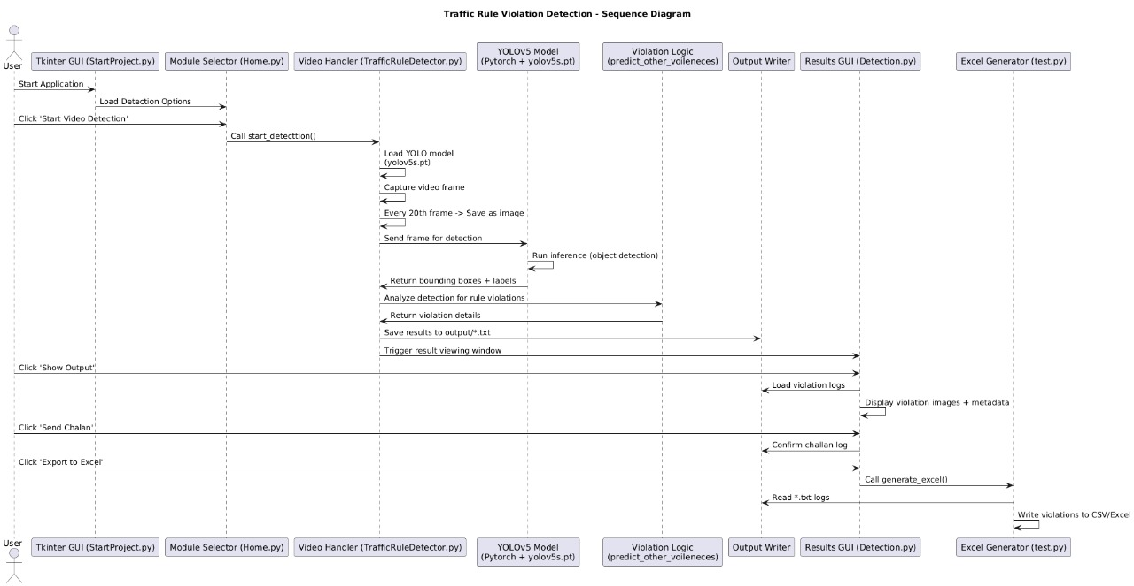
SEQUENCE DIAGRAM

Slide 5
METHODOLOGY
Vehicle Classification:
An object detection model YOLOv5 is used to classify the vehicles.
Working of YOLOv5 :
Splits the image into a grid
Each grid cell :
Predicts bounding boxes
Predicts class probabilities (e.g., helmet, bike, person)
Uses a neural network to do all this in one forward pass (fast)

Slide 6
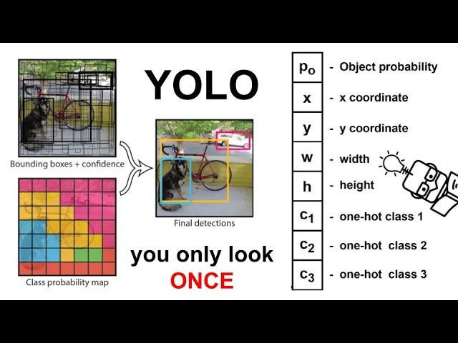

Slide 7
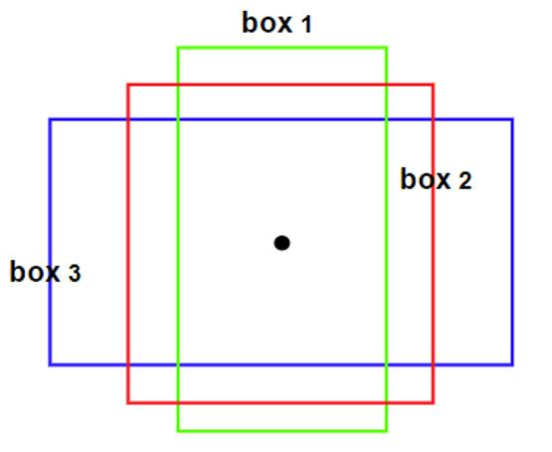
METHODOLOGY (Cont.)
Bounding Box Predictions:
In YOLOv5, bounding boxes are rectangular boxes used to define the position and scale of objects in an image. They are represented by four parameters: x, y, w, and h, where x and y are the center coordinates of the box, and w and h are the width and height, respectively. YOLOv5 uses anchor boxes as templates for predicting bounding boxes. It predicts bounding boxes at multiple scales, allowing them to detect objects of varying sizes.

Slide 8
METHODOLOGY (Cont.)
Class Prediction:
In YOLOv5, class prediction is the process of identifying what object is in the detected bounding box — e.g., car, bike, helmet, etc. A confidence score (also called objectness score) is also predicted, indicating the likelihood of a particular box containing an object.
The class probability is typically calculated using a softmax function on the output of the network, ensuring that the probabilities for all classes sum to one.

Slide 9
METHODOLOGY (Cont.)
Violation Detection:
The vehicles are detected using YOLOv5 model. After detecting the vehicles, violation cases are checked. The detected objects have a green bounding box.
If a ‘motorcycle’ is detected with a ‘person’ but without a ‘helmet’, it's considered a violation and in the next step the number plate in being tried to identify.
Hence, the number plate if identified is detected in the system which will further be used to send the e-challan .

Slide 10
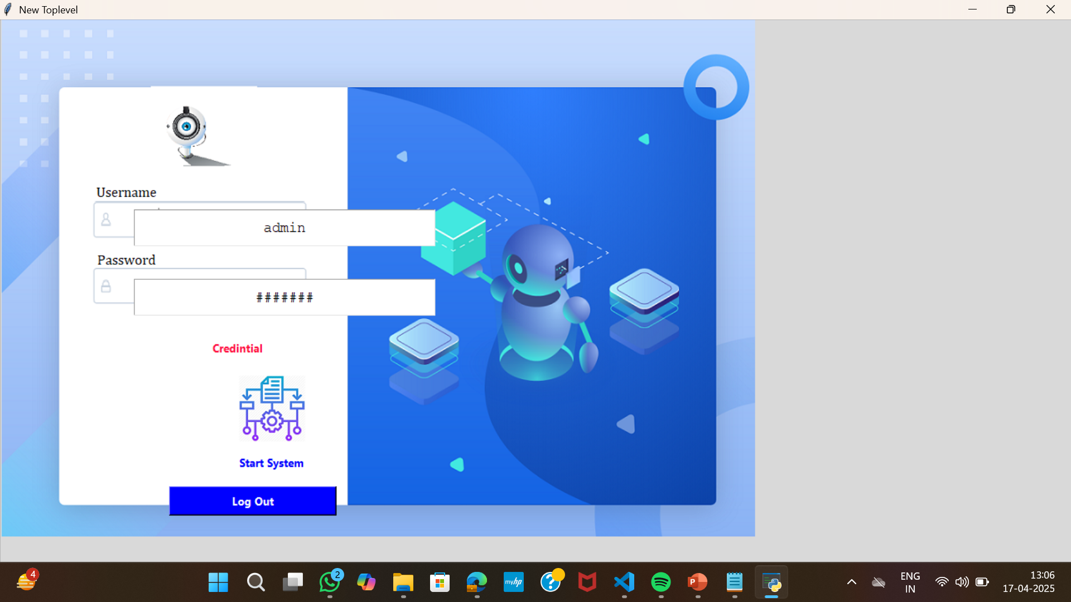
IMPLEMENTATION
The entry point for users is a GUI built using Python’s Tkinter module.. Scripts like StartProject.py, Home.py, and Detection.py form the interactive layer, allowing users to launch detection modules, view results, and export data.

Slide 11
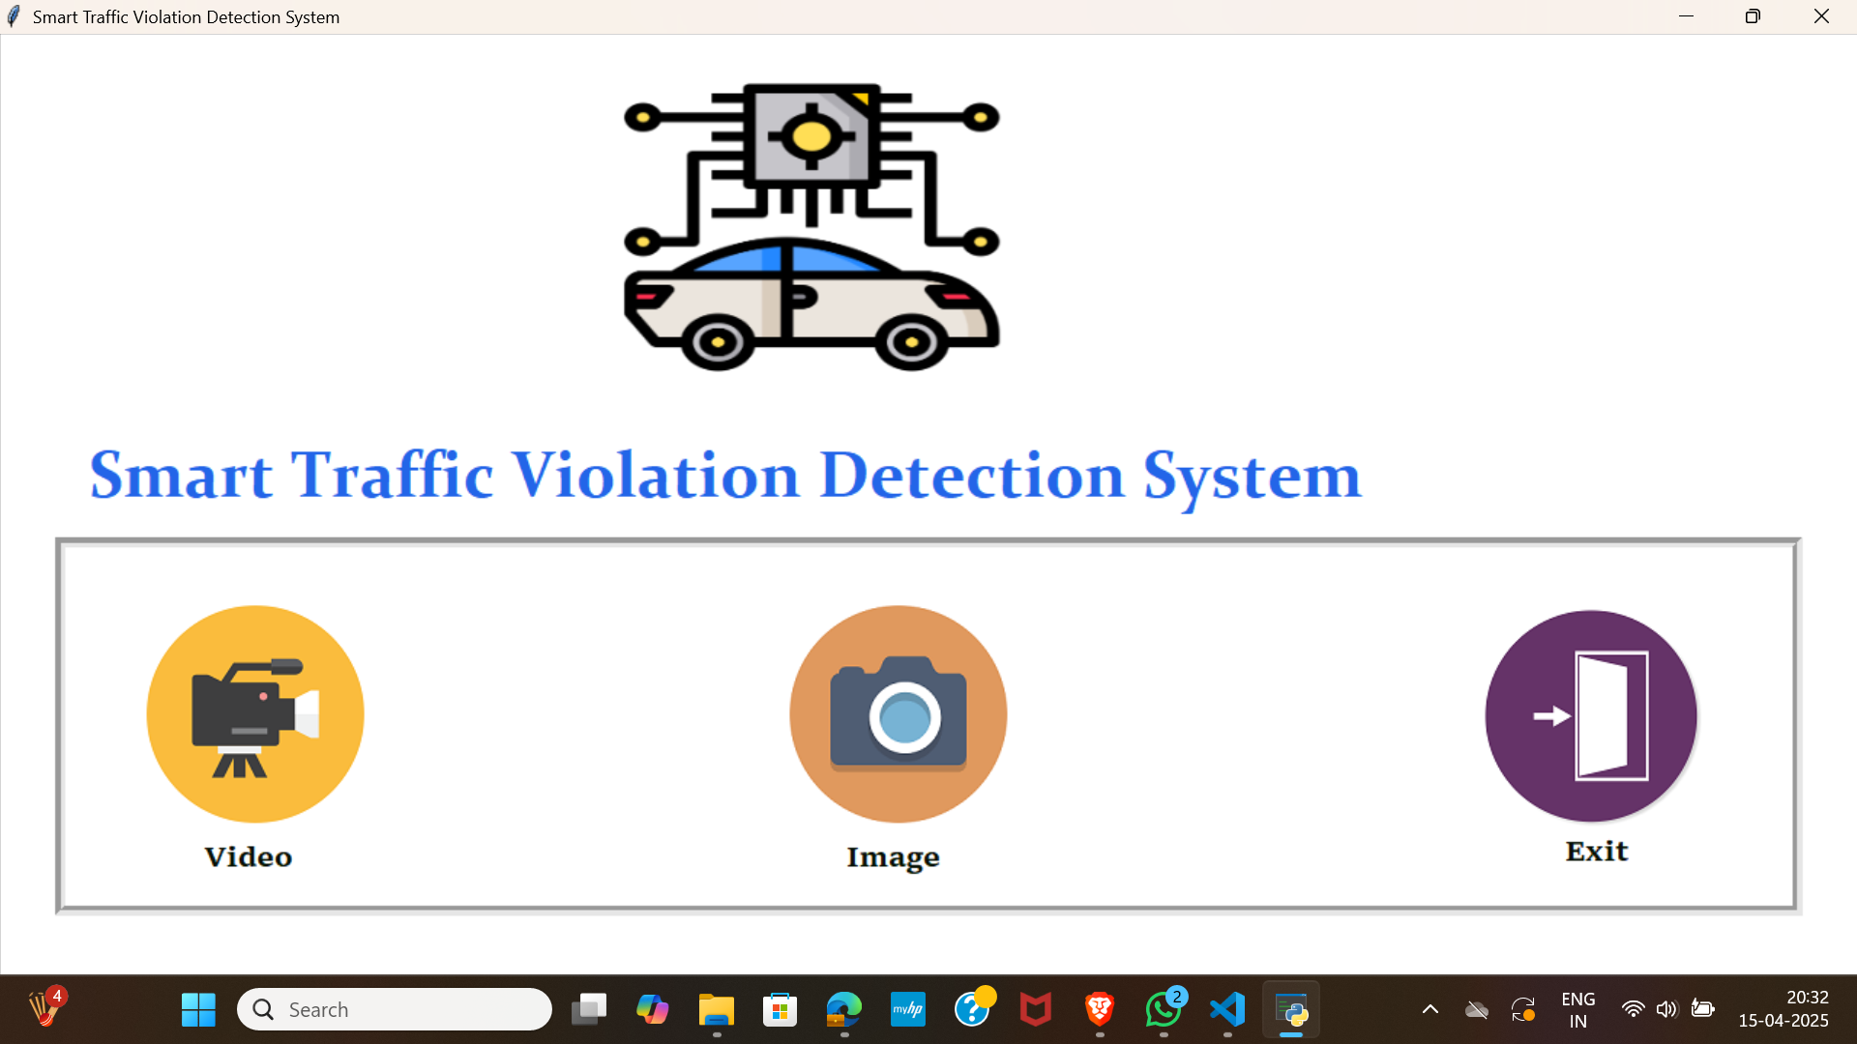
13

Slide 12
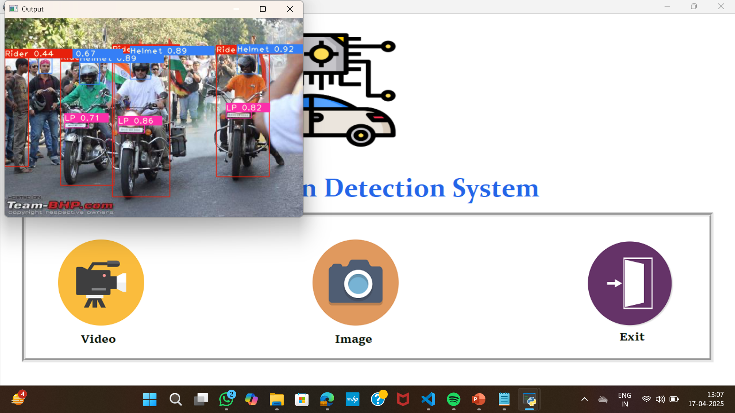

Slide 13
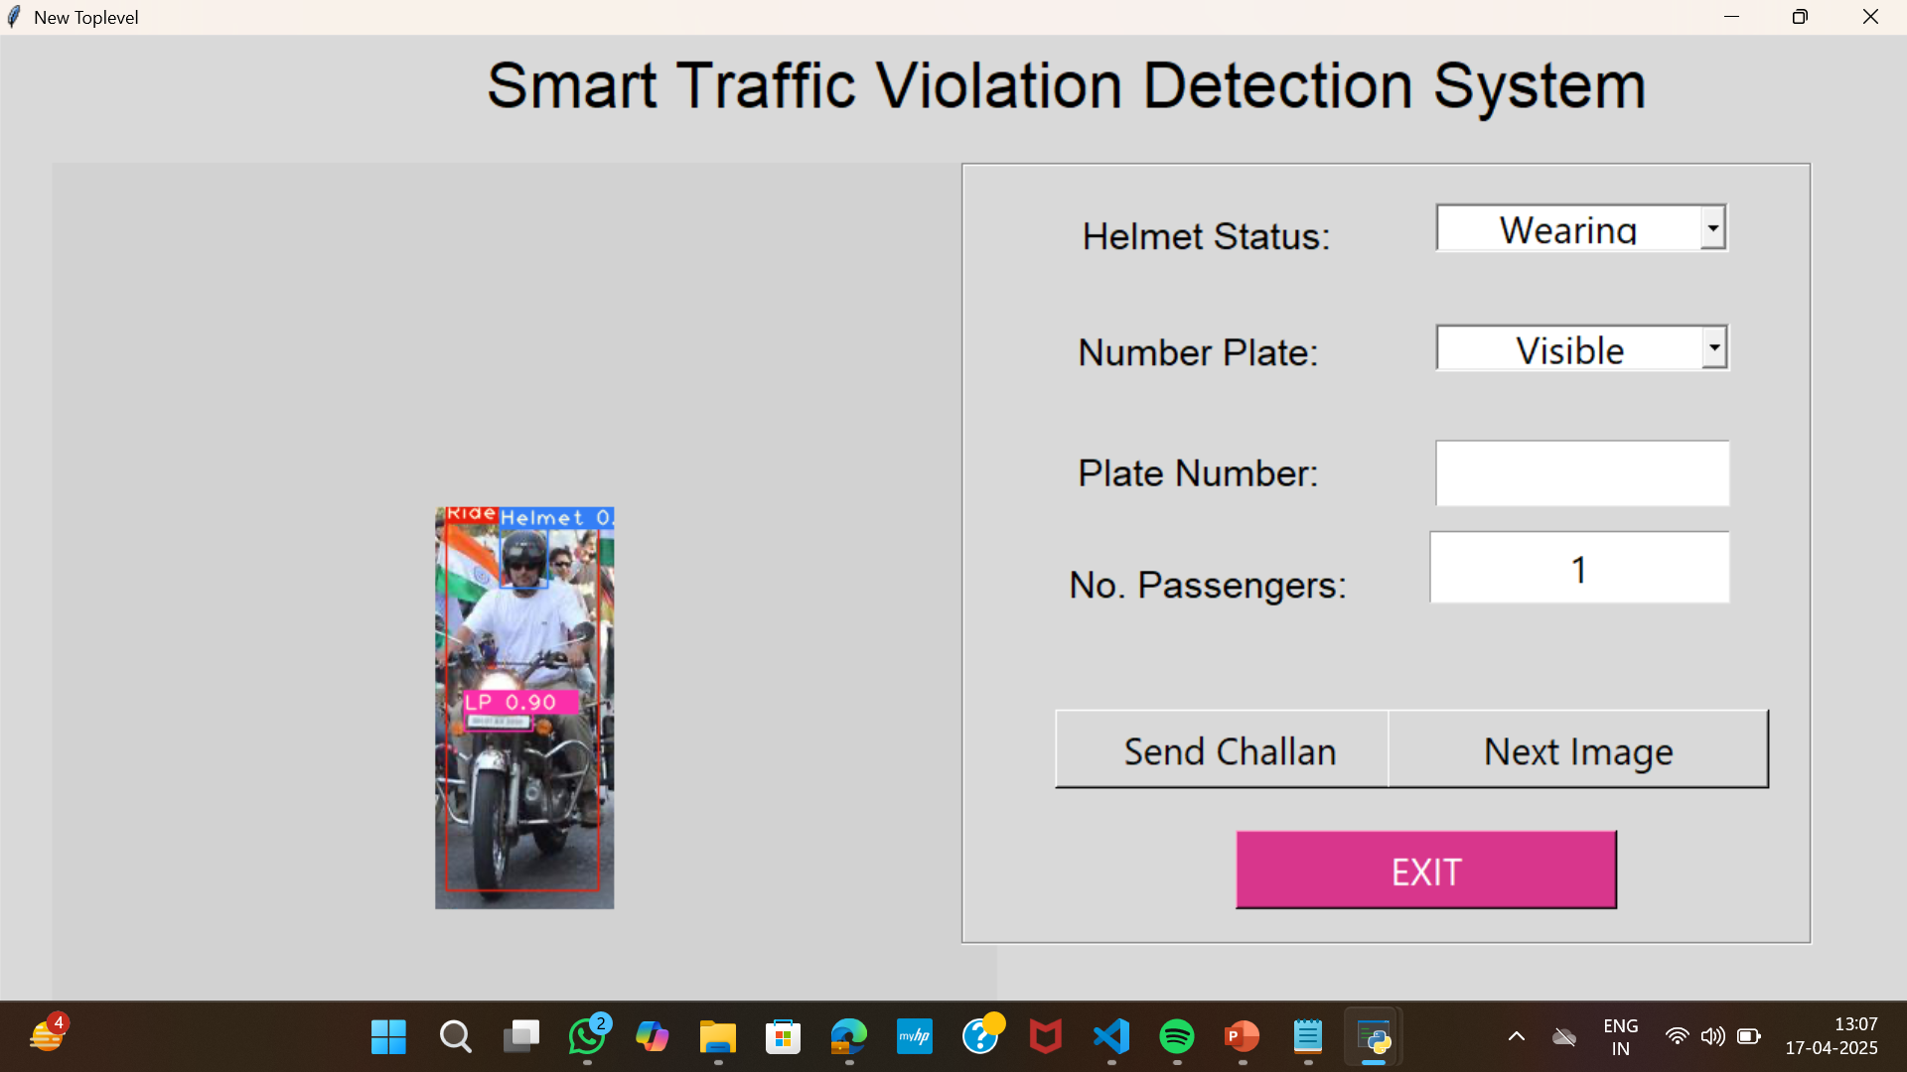
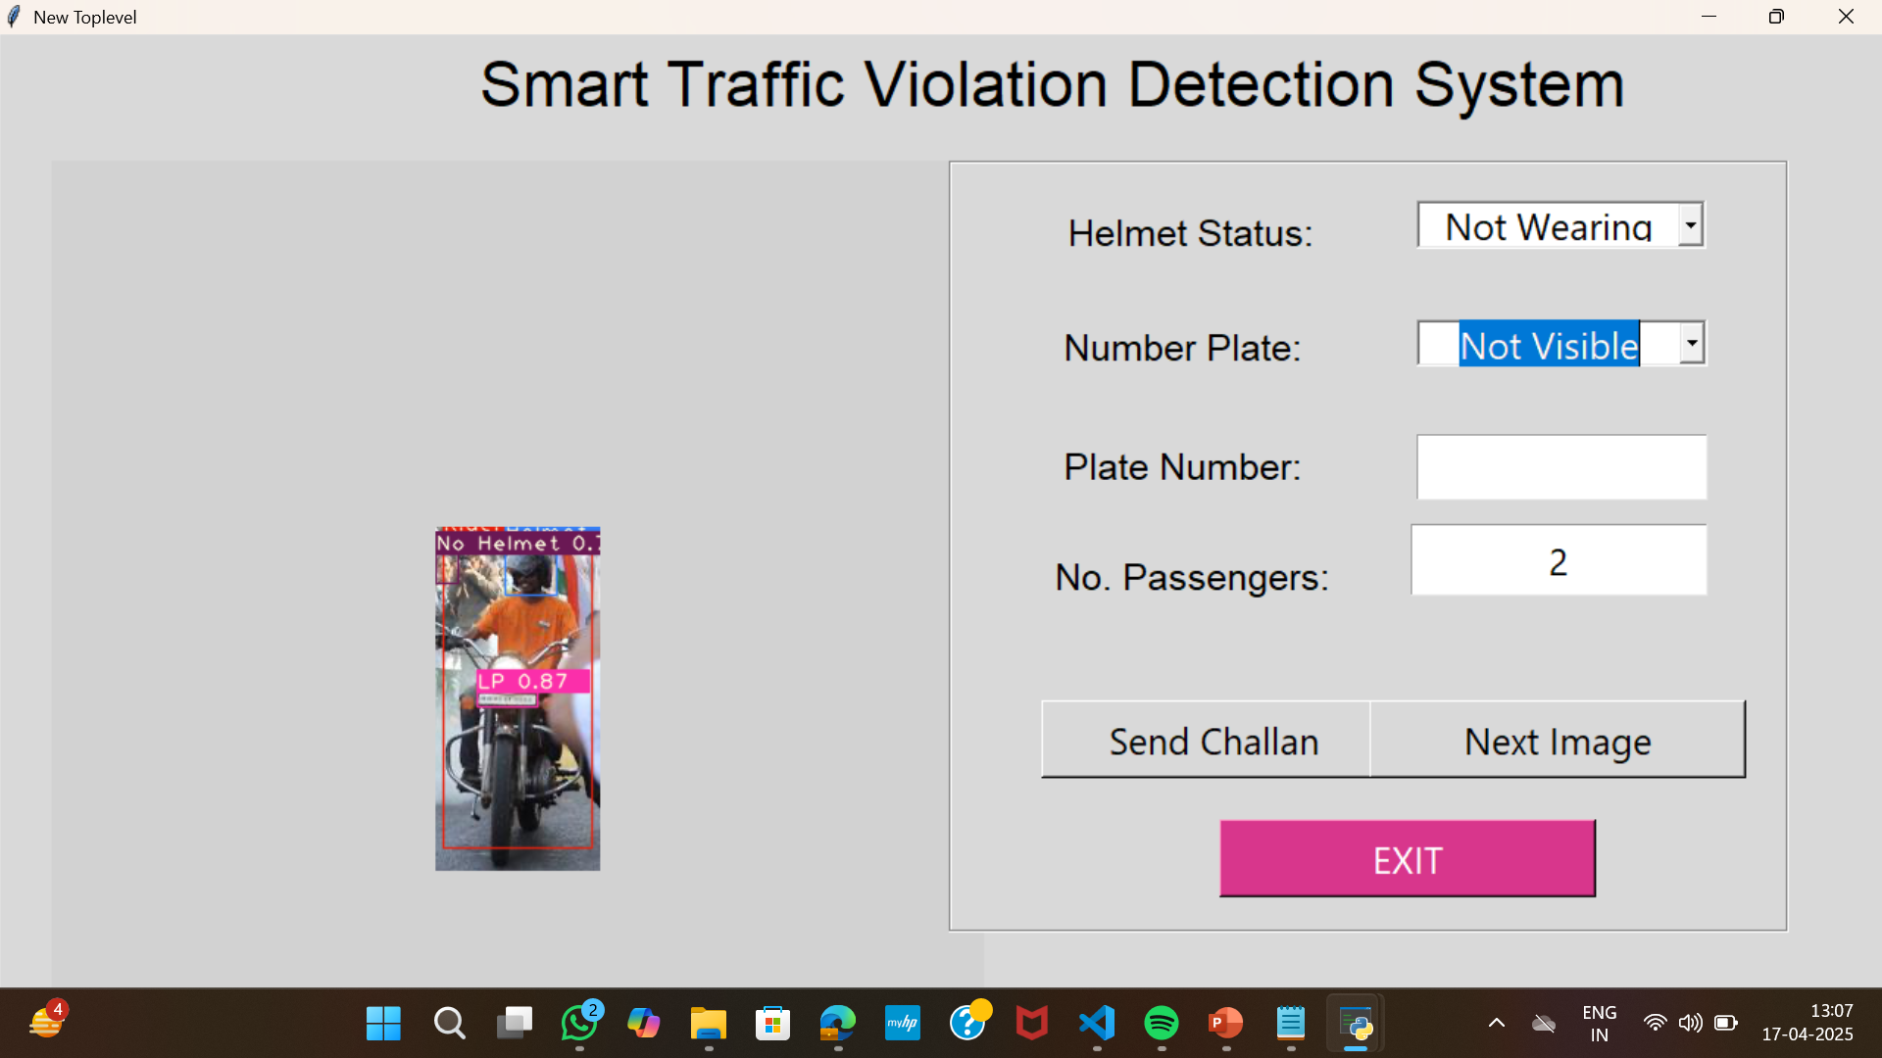

Slide 14
FUTURE SCOPE
Adding more real life features
Making this system more robust
Adding Wrong Way Detection and overspeeding detection
Adding more traffic violation conditions

Slide 15
THANK YOU

